Slide 1
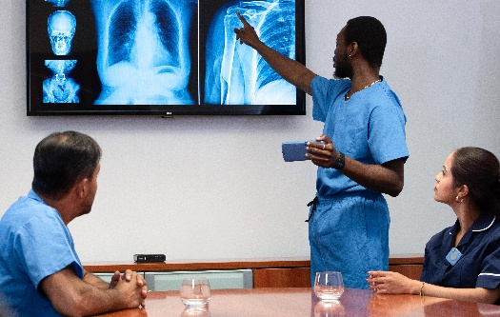
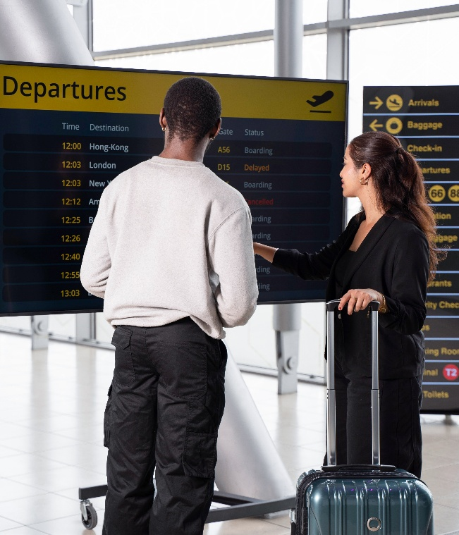

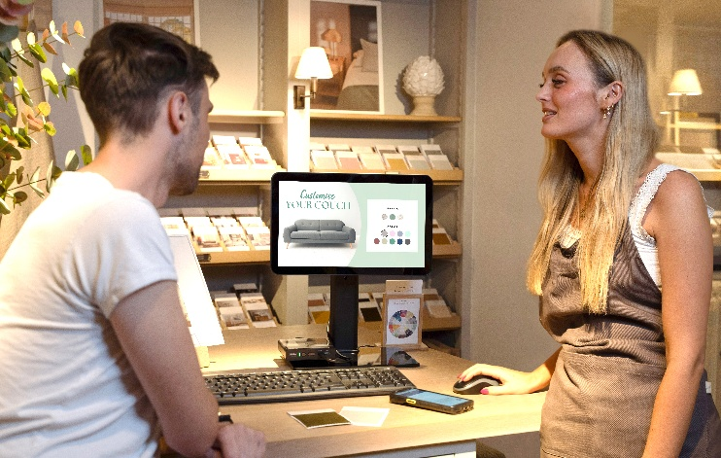
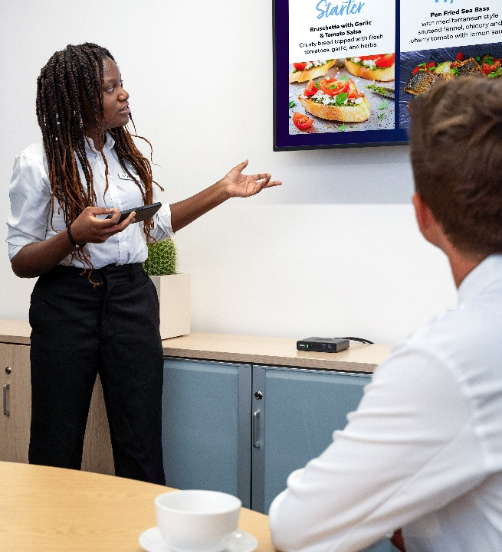

ZEC500
Enterprise Computer
The brains for any job.
The power to run any app.
The flexibility for any task.

Slide 2
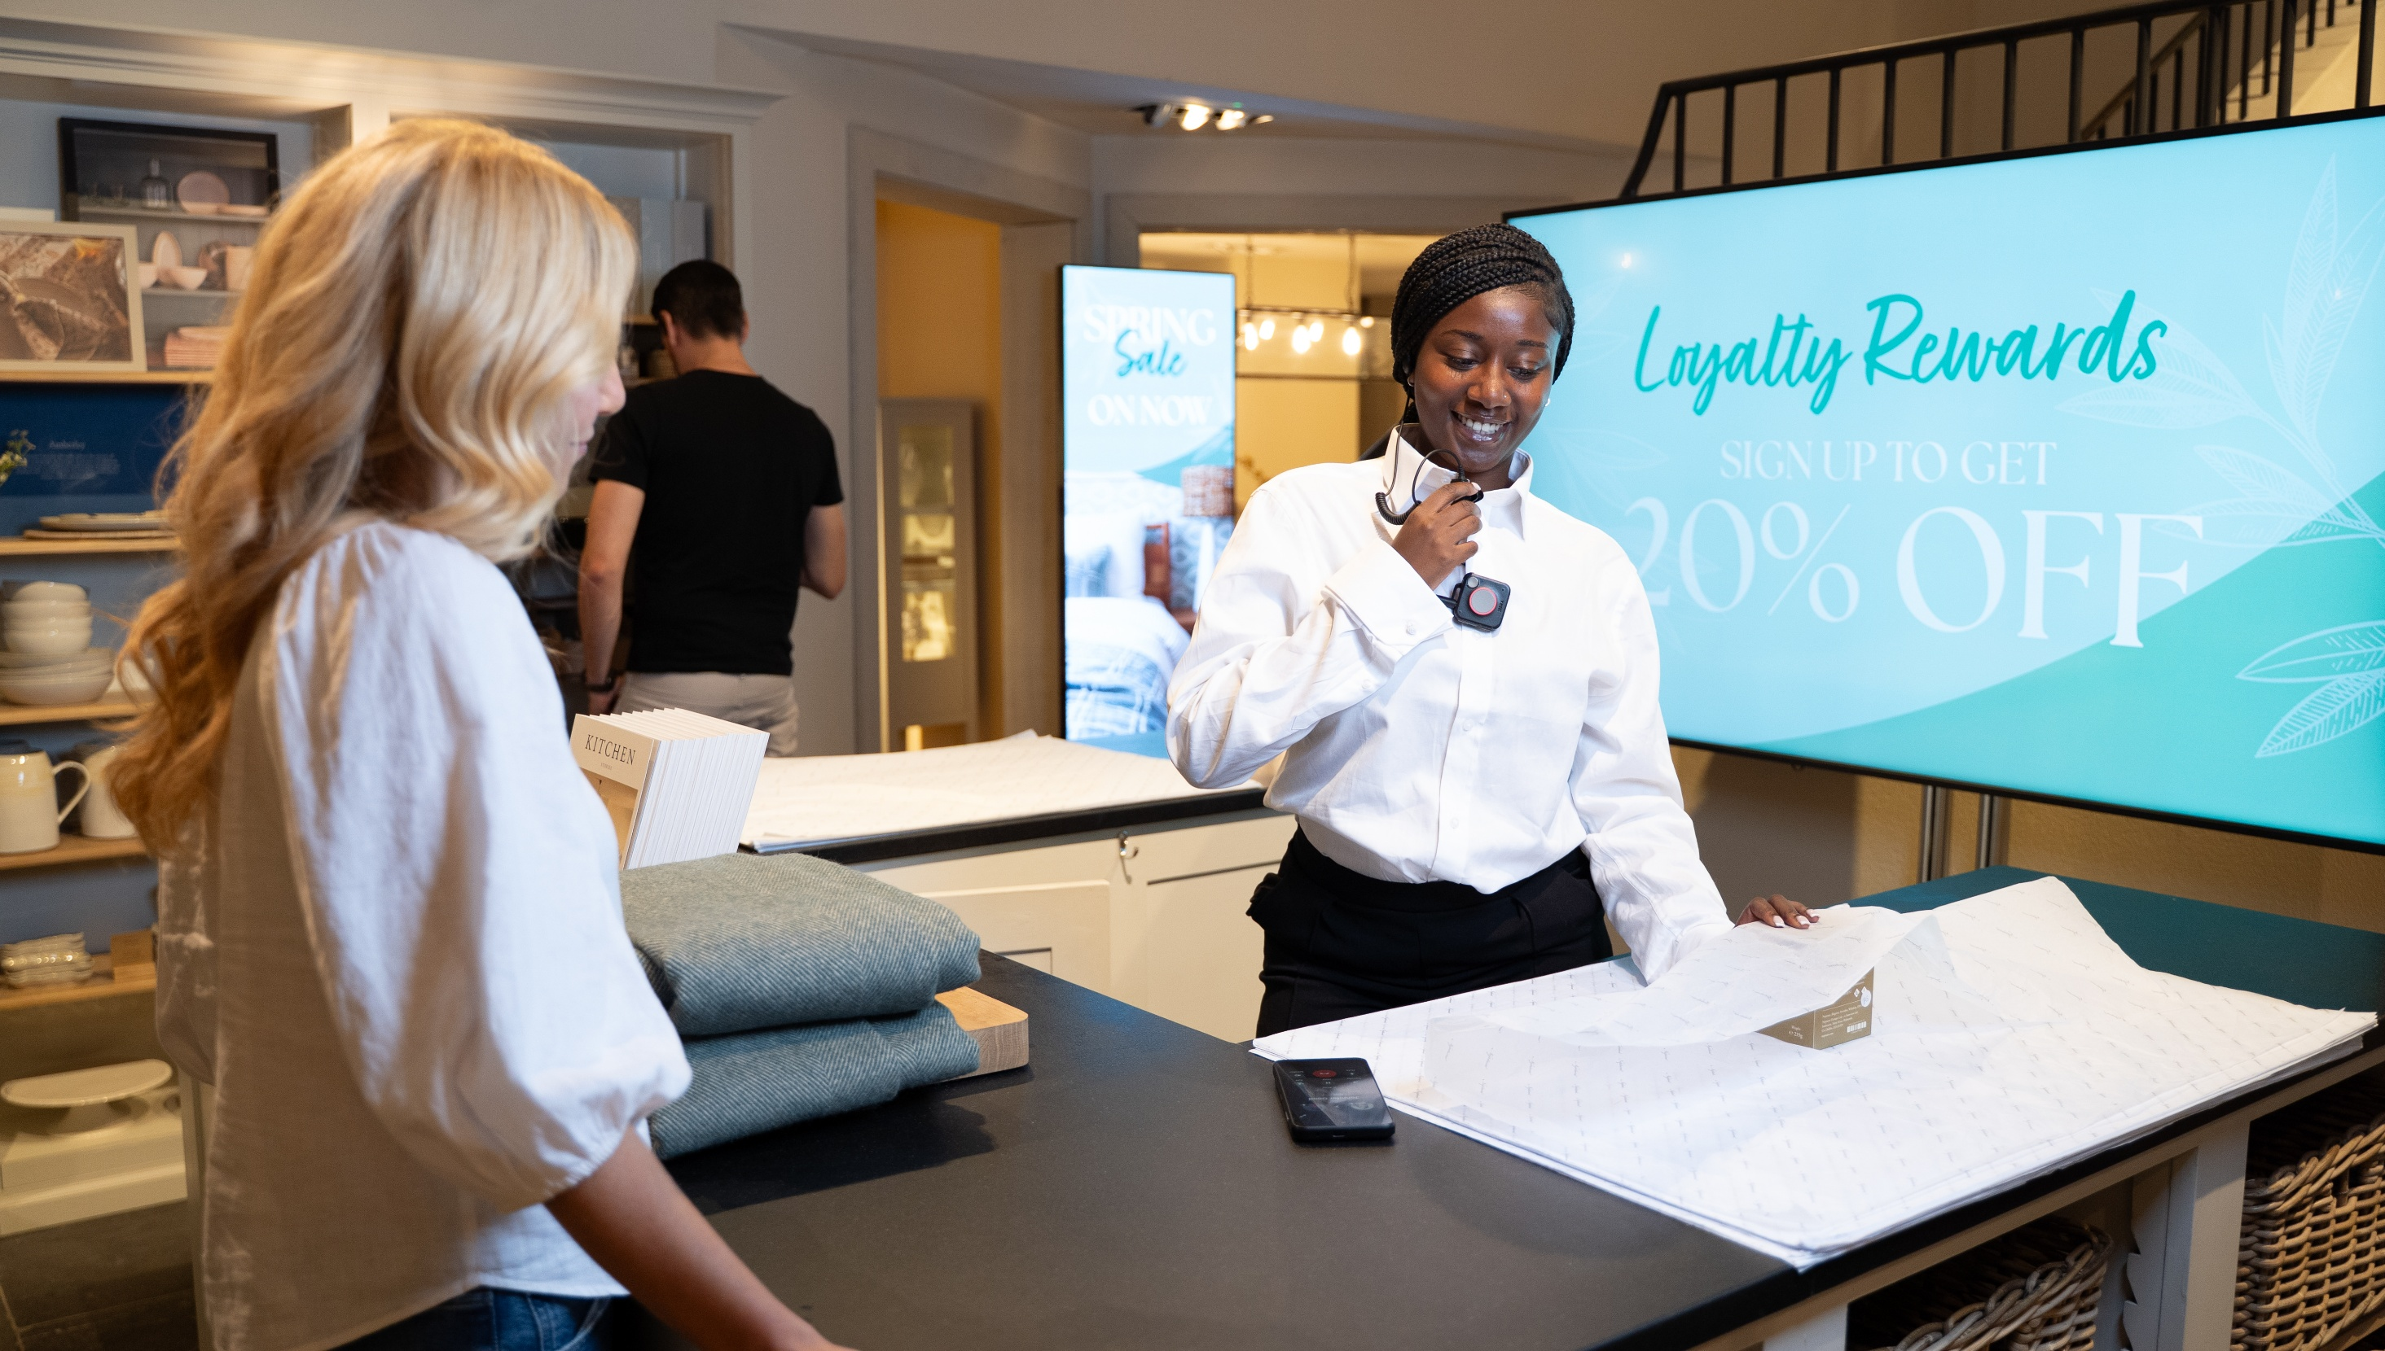

Challenge and Solution

Slide 3



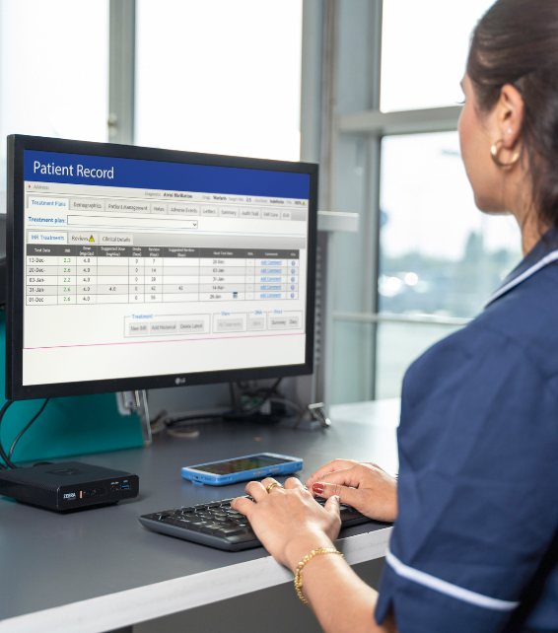

It takes a lot of different computer systems to run your business
Desktop computers
Self-service kiosks
These ‘silos’ create a fragmented
technology architecture with devices that:
Run different operating systems
Use different management tools
Are built for single-purpose tasks
Are disconnected from your mobile computing strategy
In-vehicle computers
The result?
Increased technology management time and cost
Fractured workflows that erode worker
productivity and the impact the speed and quality
of customer service
Fixed and mobile workstations
Digital signage

Slide 4
What if there was one flexible computing platform that could support them all?

Slide 5
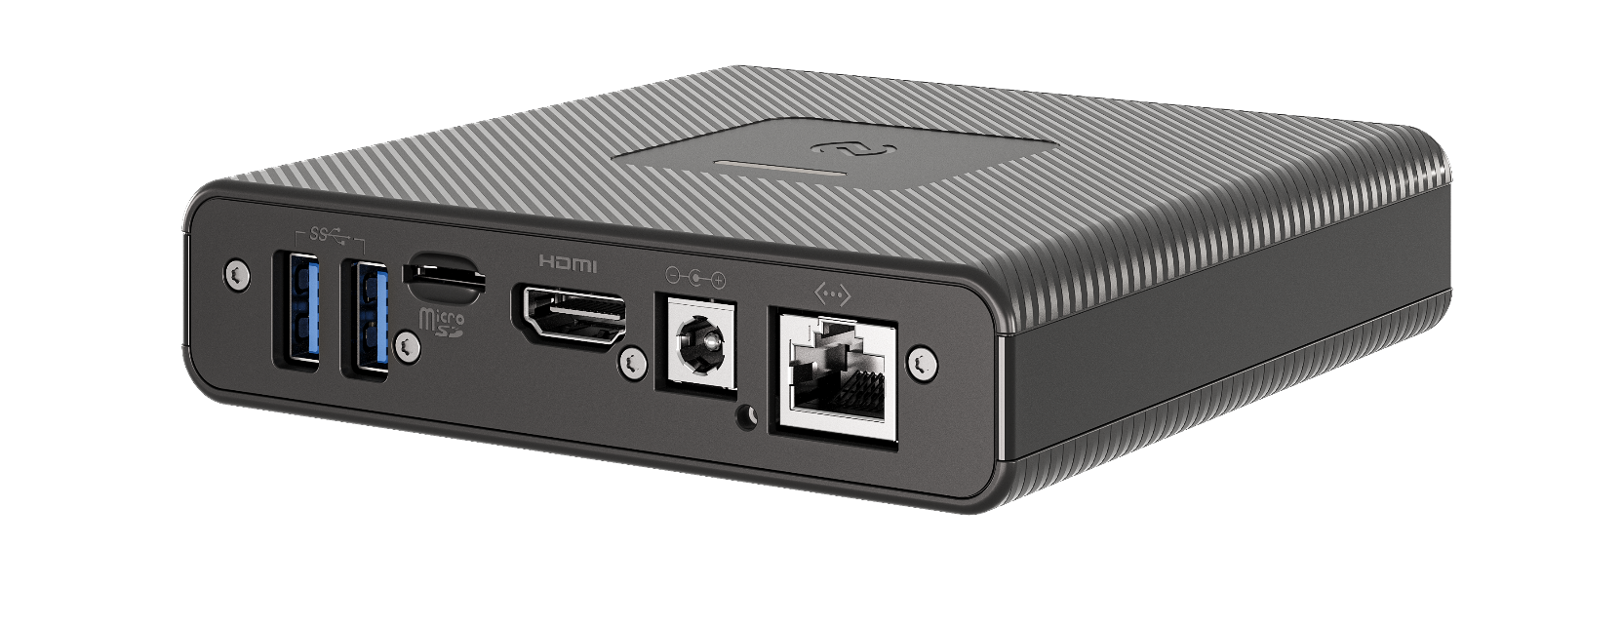
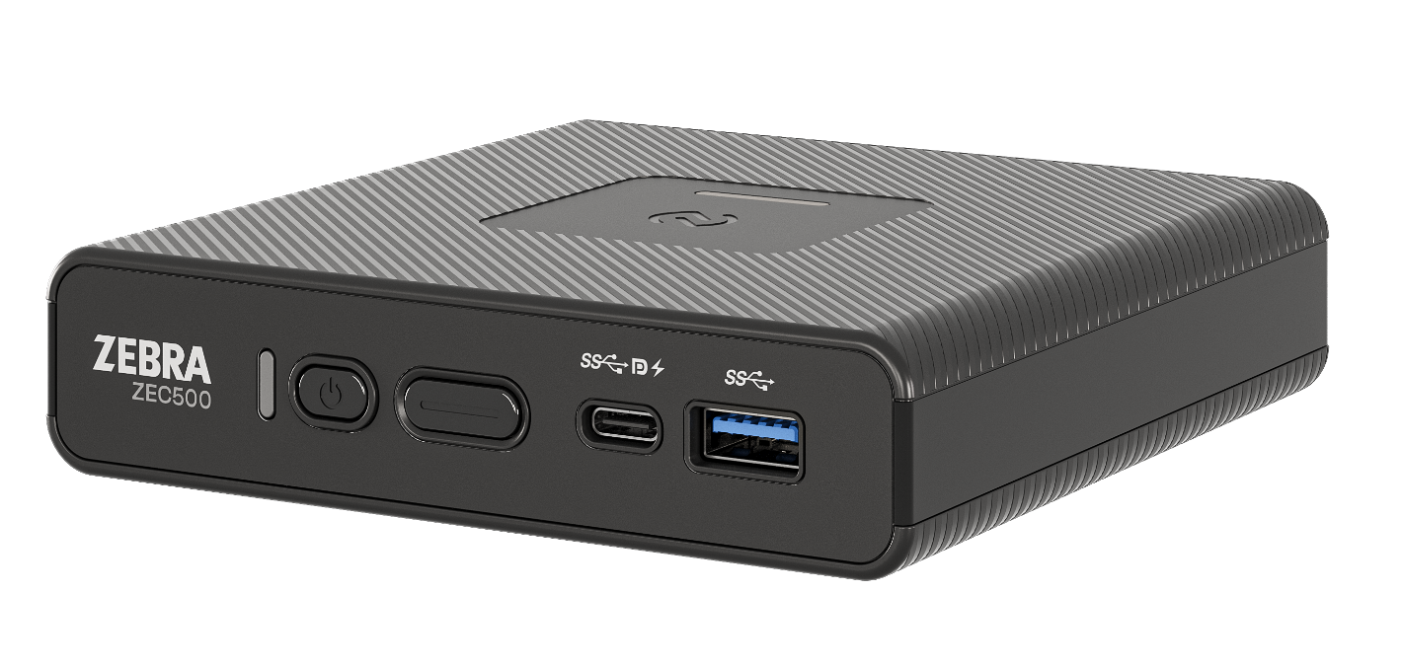
Introducing the ZEC500
Leverage the same powerful and proven Android enterprise platform in your Zebra handhelds and tablets to create just about any type of computer — ready for any job, any app, any task.
ZEBRA TECHNOLOGIES
5

Slide 6
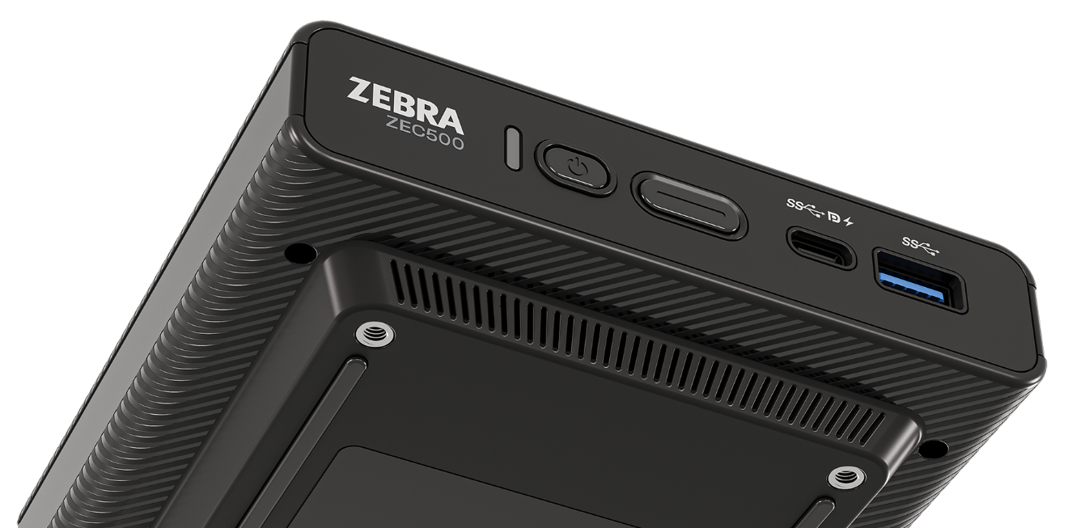
Why choose the ZEC500 for your computing needs?
Endless applications
Just add a monitor and peripherals to create a full Android solution—from digital signage and self-service kiosks to fixed, mobile or
in-vehicle workstations
Single platform simplicity
Use the same great Zebra DNA tools and Zebra solutions you use today on your Zebra handhelds and tablets, simplifying device management
Maximize the value of your Zebra mobile devices
Cast content from your Zebra handheld or tablet to any screen via the ZEC500 to enable Wireless Workstation Connect
Enterprise-class
Durable, secure, and manageable — just like your Zebra mobile devices
Install it anywhere
With standard VESA mounting and PoE++
Enterprise-grade support
The same Zebra OneCare service protects all your Zebra devices

Slide 7
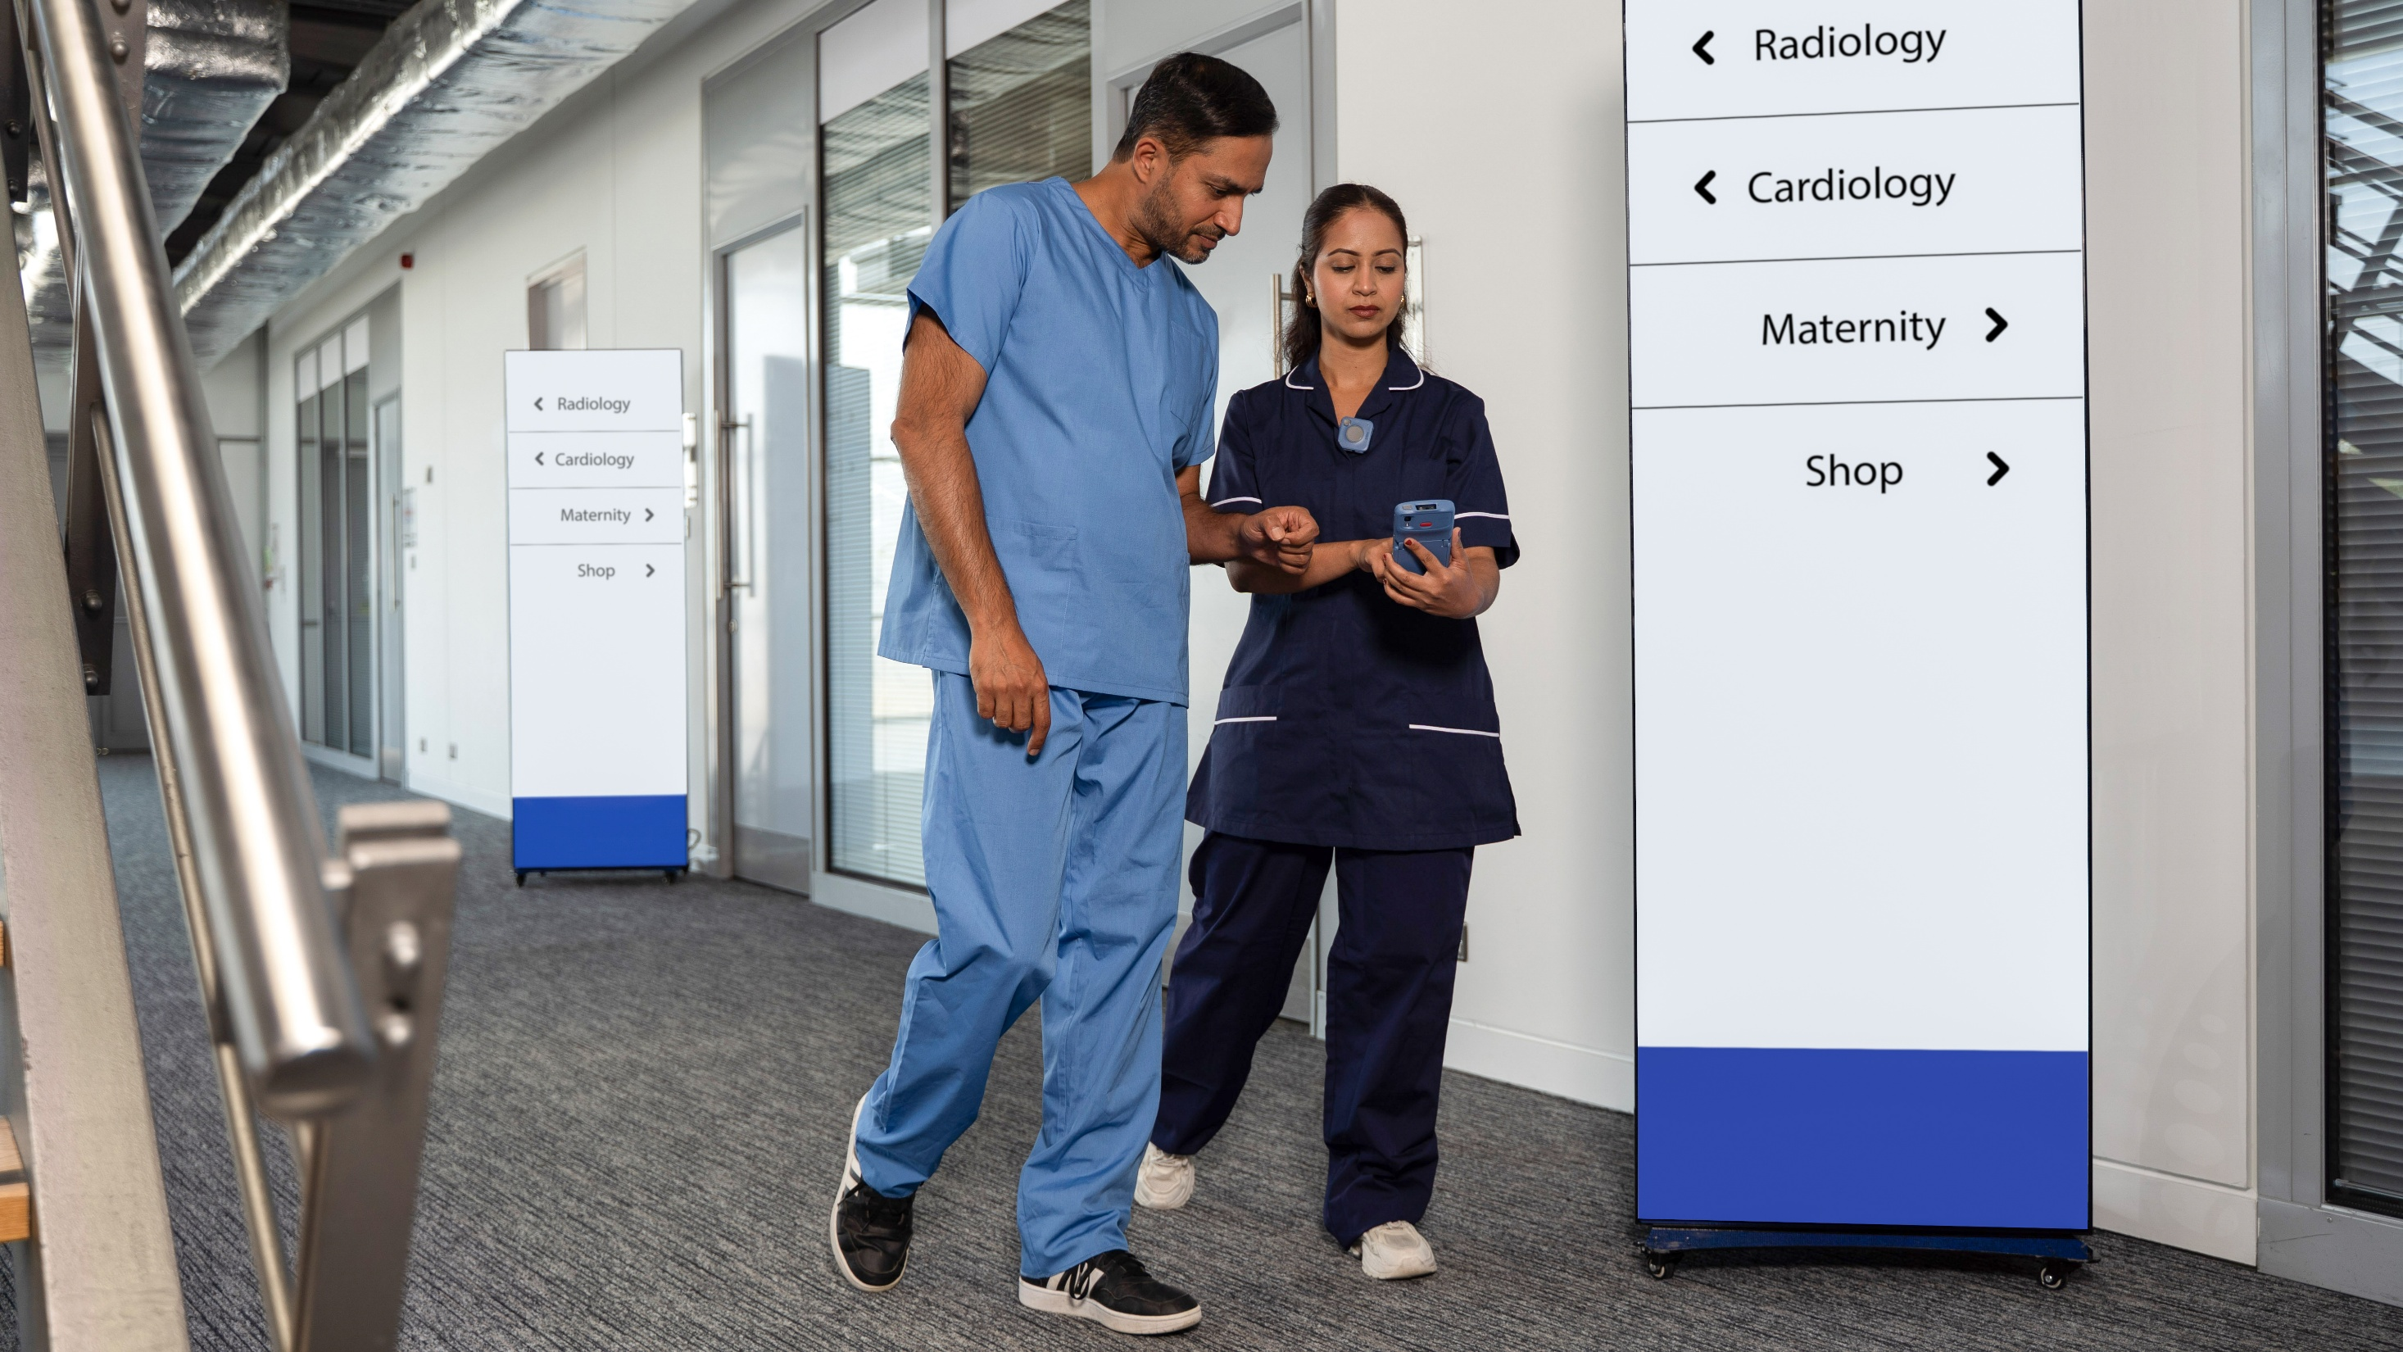
Markets and Applications

Slide 8

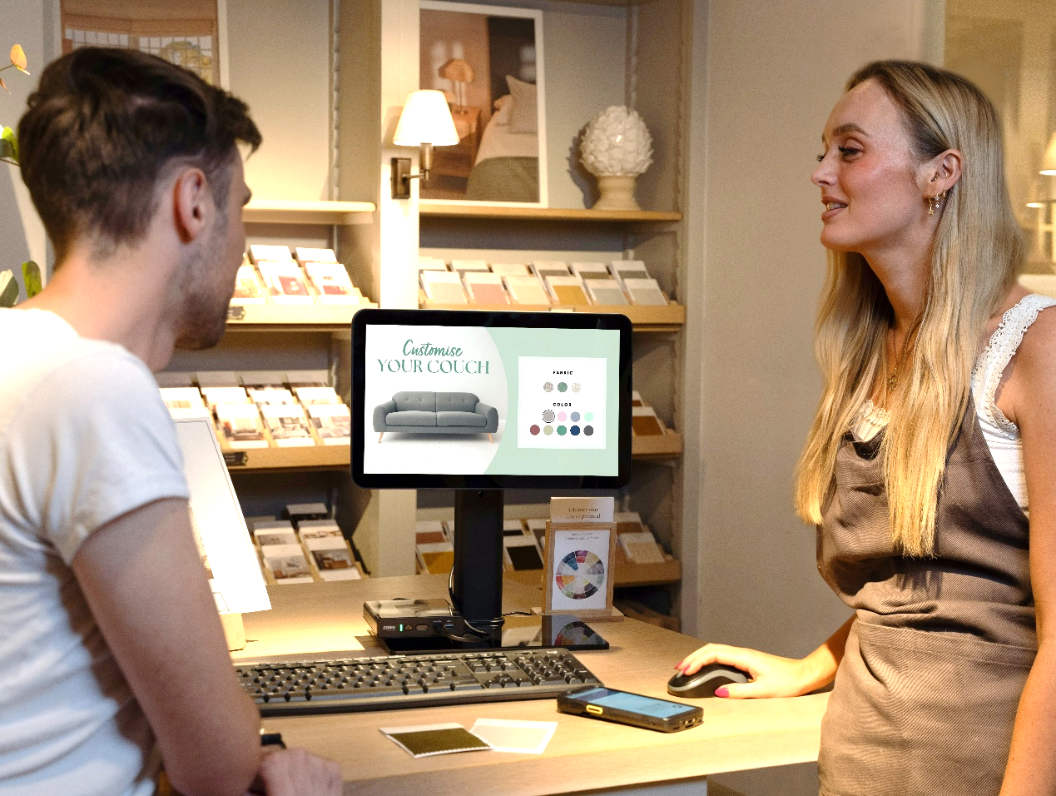
Retail
Elevate the in-store experience with digital signage and real-time personalized content—and self-service options improve staff efficiency and allow you to serve more shoppers with ease.
APPLICATIONS
Digital signage/
media player
Retail Media Networks
Kiosk/self-service
Assisted selling
Workstations
8

Slide 9
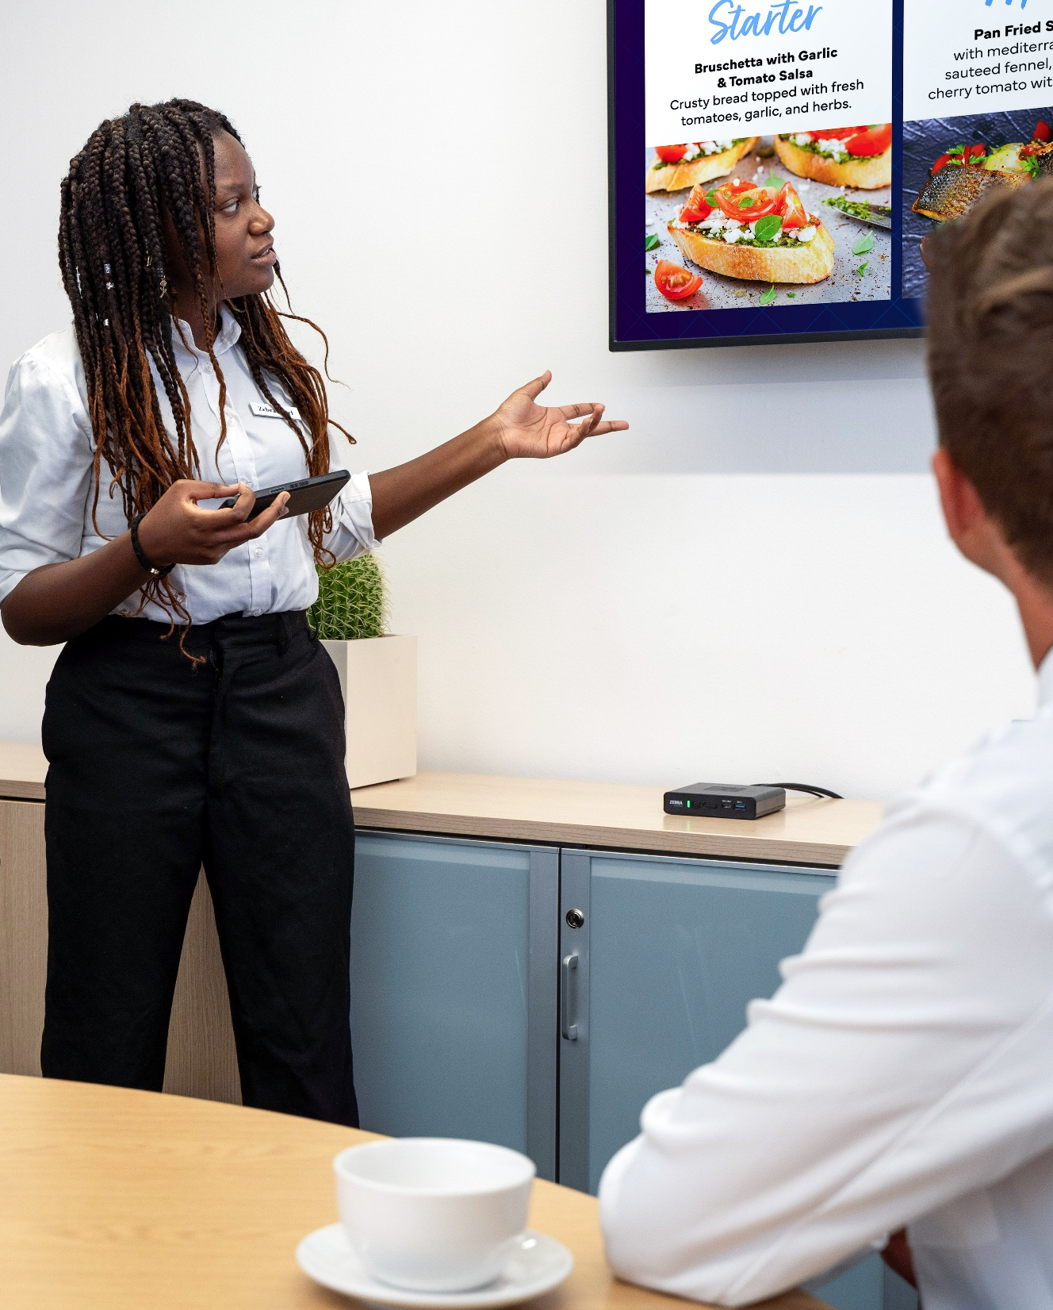
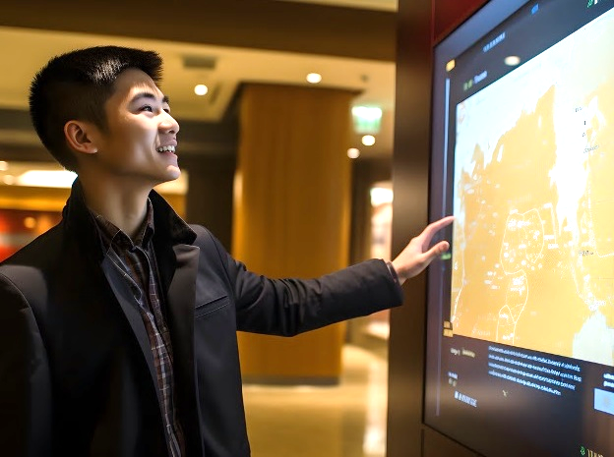
Hospitality
Make every guest feel like VIP every moment of every stay with effortless self-service options and eye-catching digital signage that showcases your amenities, promotions and events.
APPLICATIONS
Digital signage/
media player
Check-in/
check-out kiosk
Guest assistance
Employee workstations
9

Slide 10
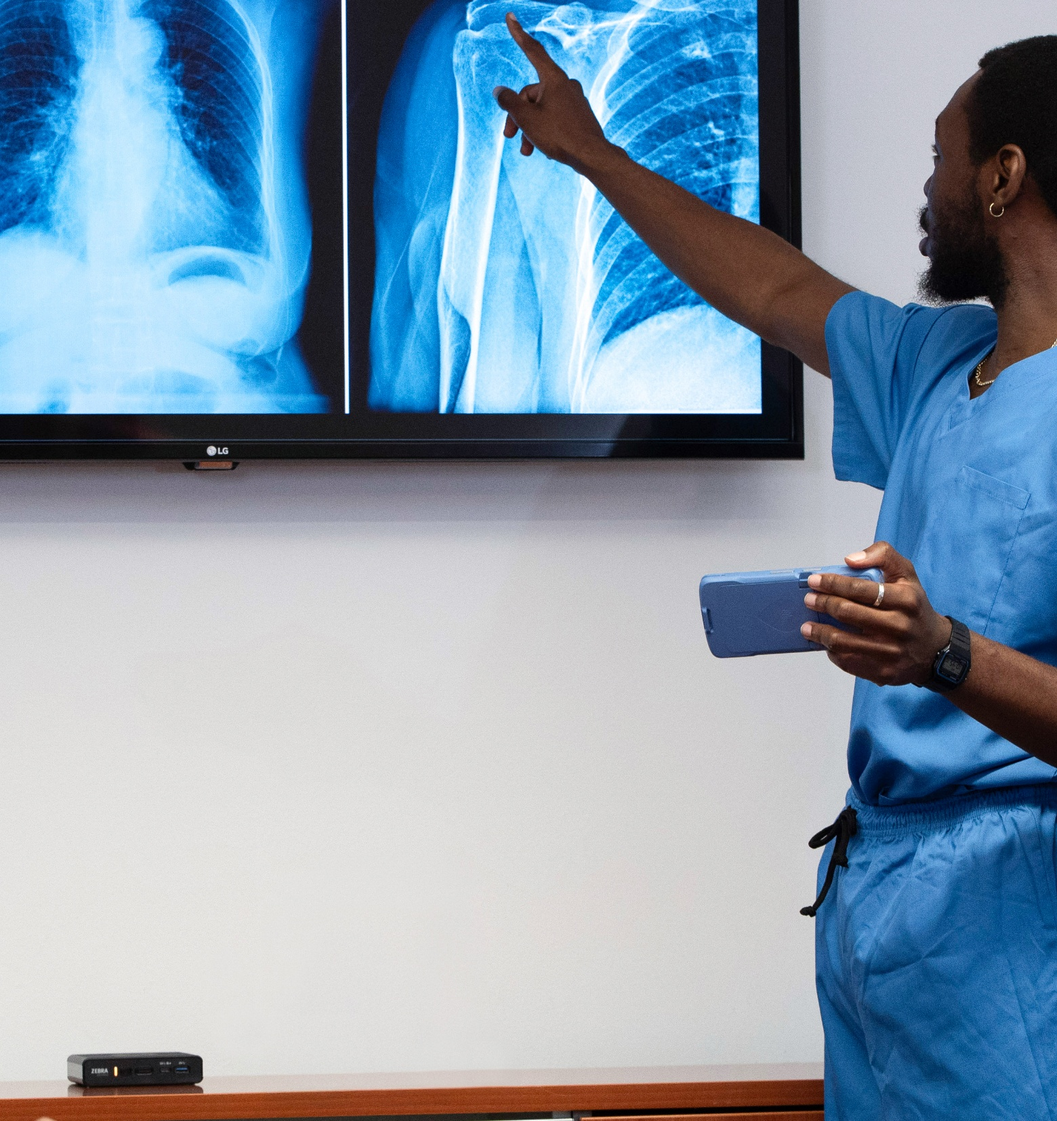
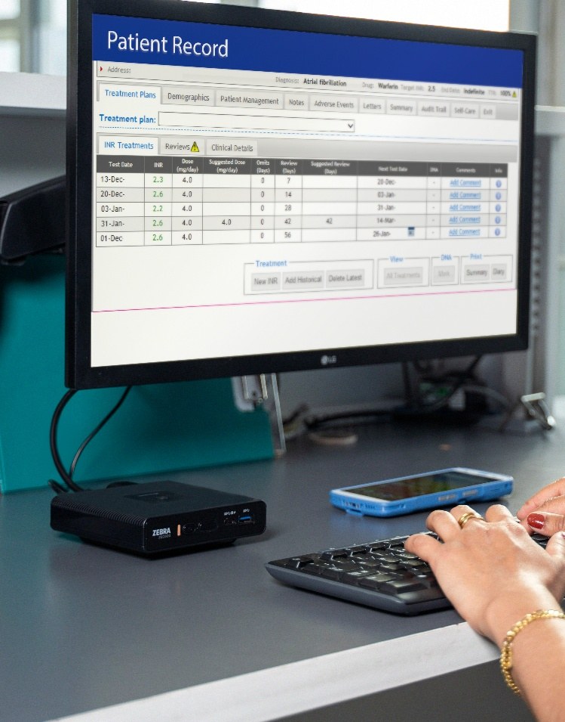
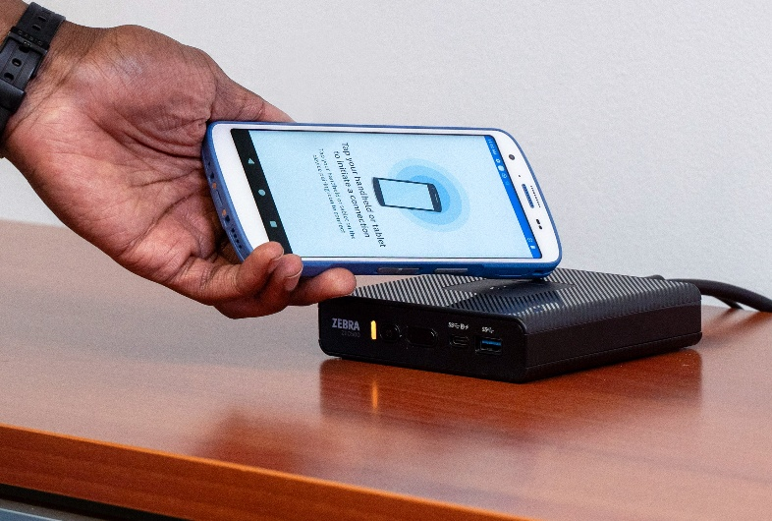
Healthcare
Create a more connected experience for patients, visitors and staff, streamline everyday tasks and increase staff efficiency, while improving the quality of care.
APPLICATIONS
Digital signage/
media player
Check-in kiosks
In-room display
Admission and
discharge forms
EHR access
and update
Process automation
Workstations
Training
10

Slide 11


Public Safety
Simplify in-vehicle technology and make it easier and more efficient for officers to do their job on the road. Seamlessly cast from a Zebra mobile device to ZEC500 equipped with a larger screen and keyboard, allowing officers to access and enter data faster and easier.
APPLICATIONS
E-Citation
Computer Aided
Dispatch (CAD)
Records Management System (RMS)
Information systems
(local and national)
Law-enforcement applications
11

Slide 12


Warehouse and Manufacturing
The ZEC500 helps you work faster and leaner by turning any screen into a dynamic workstation or real-time digital display to keep workers focused on goals.
APPLICATIONS
Digital signage/media player
/digital whiteboards
Training
Warehouse manager workstation
Work schedules
Report/presentation preparation
Printing: paper barcodes,
RFID and shipping labels
Compute model for automated processes
Pack out/Pack bench/
Packing and kitting stations
12

Slide 13
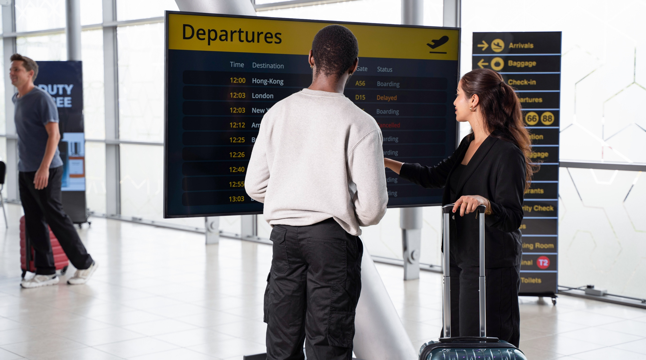
Key Features

Slide 14

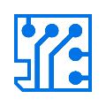
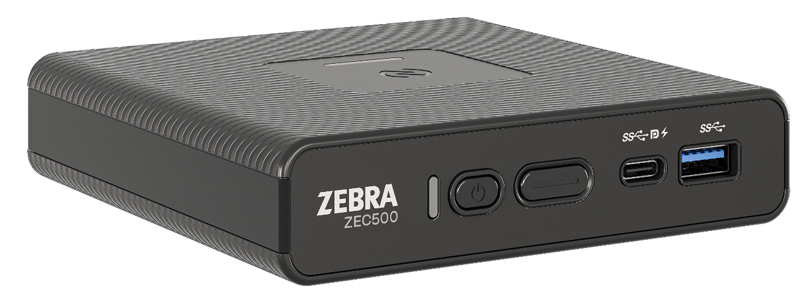


A powerful, standalone Android enterprise computer
Enterprise-class performance
Powered by an advanced Qualcomm® chipset, generous memory,
and Android 14 — with future OS support built in
AI-ready architecture
Built on Qualcomm’s 5430 octa-core 2.1 GHz processor, with robust SoC with Neural Processing Unit (NPU) to enable next-gen AI use cases
A single Zebra Android platform to meet
all your computing needs
Get the same reliability, durability, lifecycle, security and
manageability for all your Zebra enterprise devices
The simplicity of a single set of tools to deploy and manage
all of your Zebra devices, reducing management time and cost
Extraordinary lifecycle
Guaranteed availability for sale for four years plus service for
eight years to meet computing needs today and tomorrow

Slide 15
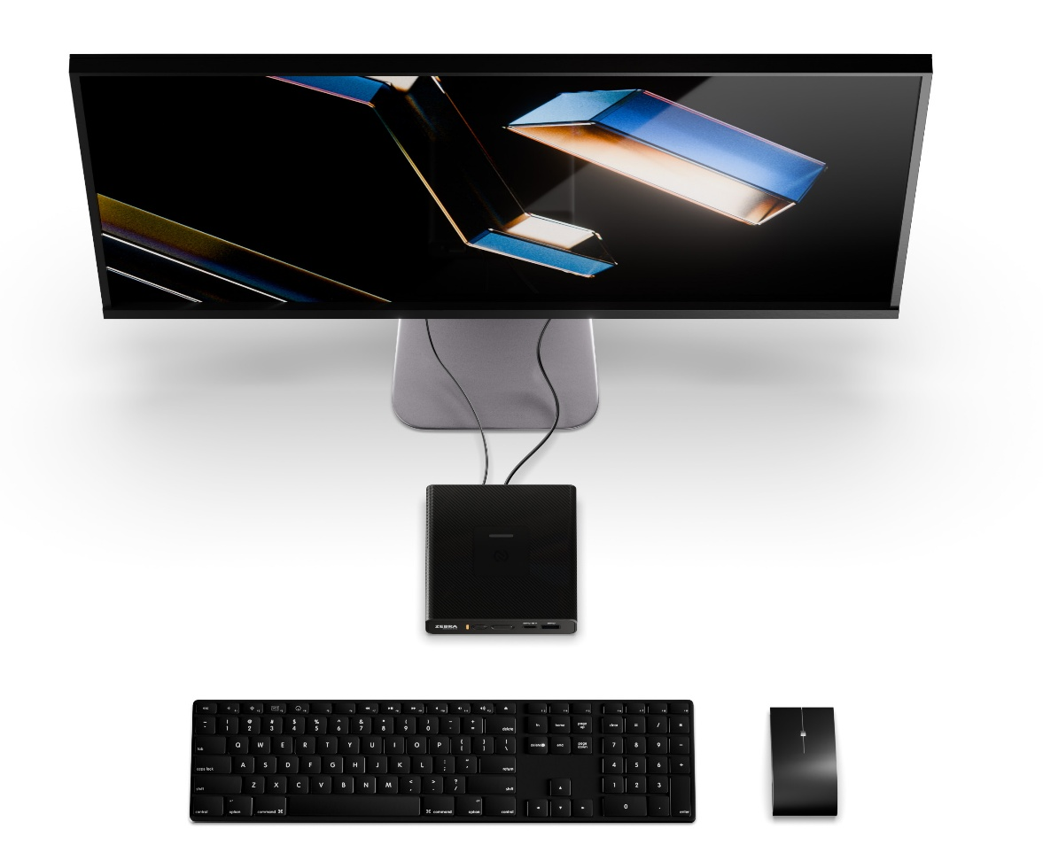




Add the display of your choice and any needed peripherals
Flexible, high-performance I/O built for the enterprise
Touch or non-touch — any size
Supports 1 or 2 displays via HDMI or Display Port
Crisp 4K resolution for clear text and rich visuals
Your tools. Your way
Three (3) USB-A ports and one (1) USB-C port for wired accessories
Bluetooth 5.3 to connect wireless devices
Easily connect keyboard, mouse, scanner, printer, speakers, headset, and more
Connect your way—wireless and wired
Connectivity options include Wi-Fi 6E, an Ethernet port, NFC antenna and Bluetooth 5.3
Whatever the setup, the ZEC500 connects it all— simply and securely
15

Slide 16
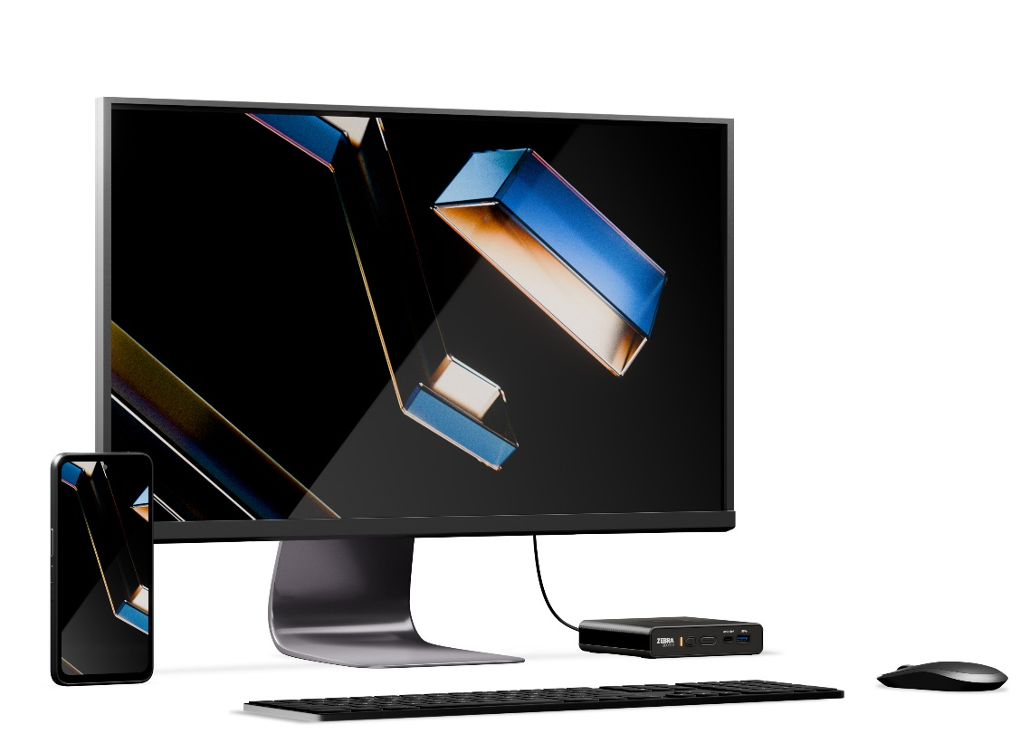
Easy to deploy anywhere
A minimal footprint and maximum flexibility for easy deployment anywhere
Ready for any environment — indoors or out
Deploy in store aisles,
drive-thrus, garages,
exit booths, and more
Choose from two models:
  Standard Range:
  32°F to 104°F
  (0°C to 40°C)
  Extended Range:
  -20°F to 140°F
  (-29°C to 60°C)
IP54 sealed—dust-safe and spill-resistant
Virtually invisible, anywhere you
mount it
Compact, lightweight, and VESA-compliant
Mount on a wall, behind a monitor, under a counter, or inside a kiosk or mobile cart
Sleek form factor fits seamlessly into customer- and employee-facing environments
Simple, low-cost
Installation options: PoE++* and USB-C
PoE++ delivers up to 90W over Ethernet
  Powers the ZEC500,
  a display and multiple peripherals
  Eliminates the need for power outlets— reducing cost and complexity
  Use any standard USB-C cable
  * PoE++ available only on Premium devices

Slide 17



Easy to manage and secure
Remote management made simple
Manage, configure, and secure every ZEC500 remotely using your preferred MDM/EMM
Get real-time visibility into device health and status
Proactively diagnose and resolve issues before they impact operations
24/7 enterprise-grade security
LifeGuard™ for Android™ keeps your ZEC500 secure with regular OS security updates — for the entire device lifecycle
Identity Guardian restricts access to authorized users only, adding a critical layer of user authentication

Slide 18


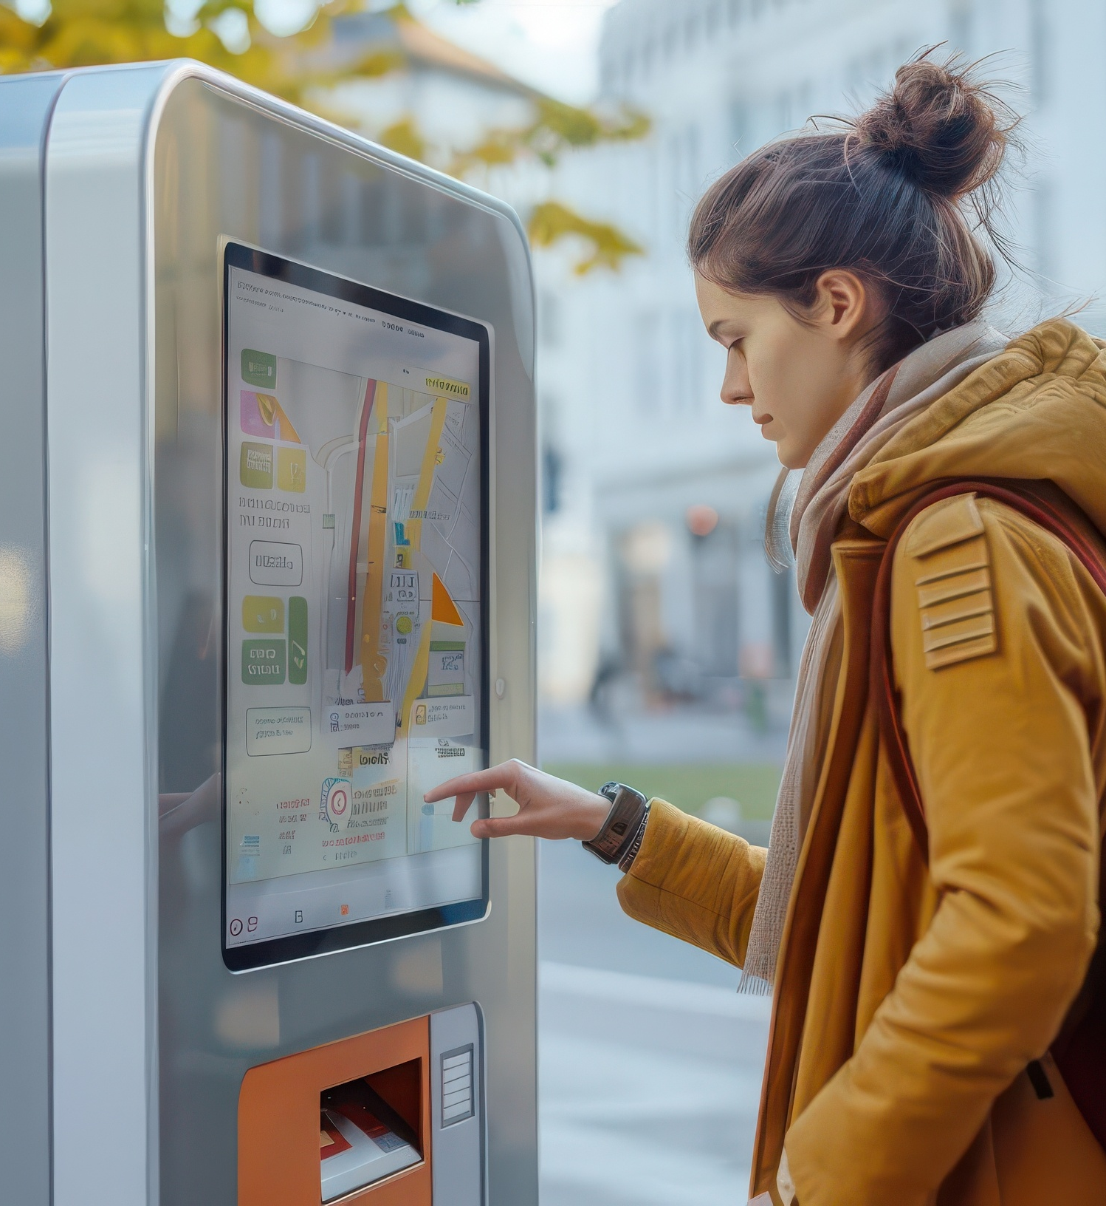
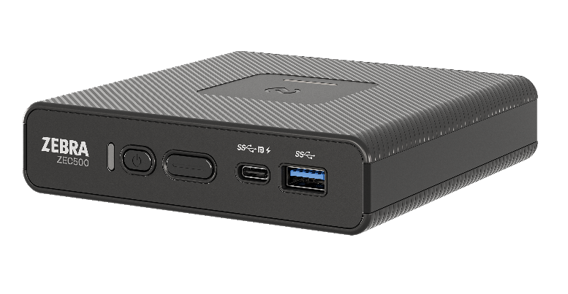
Do more with less: multi-function enterprise computing
One computer.
Many roles.
Change roles on demand.
Digital Signage
Desktop Workstation
Self-Service Kiosk
Instead of blanketing your operations with single-purpose computers, you can consolidate hardware, lower capital expenses and reduce IT overhead
At any time, an associate can wirelessly connect to any ZEC500 and use the screen as a workstation for assisted selling, scheduling and more

Slide 19
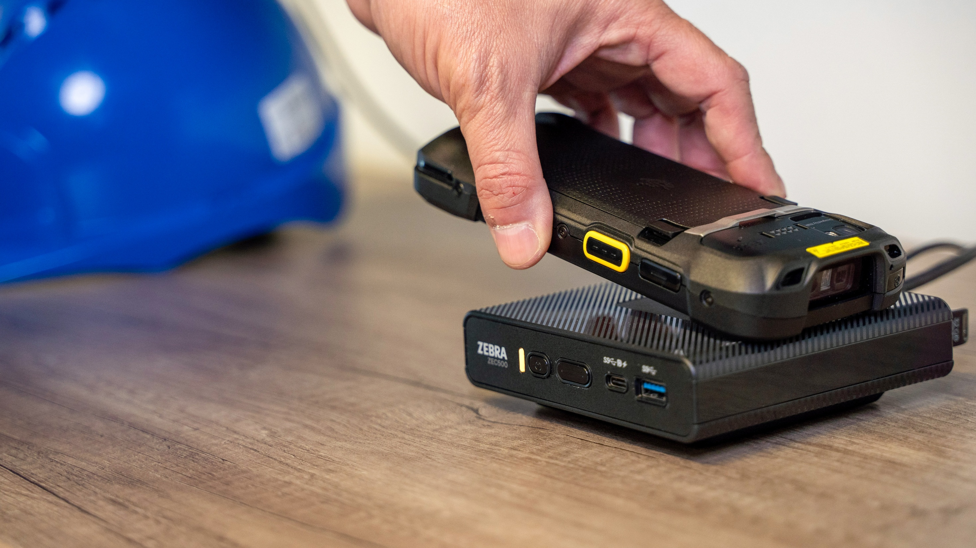
Workstation Connect goes wireless

Slide 20
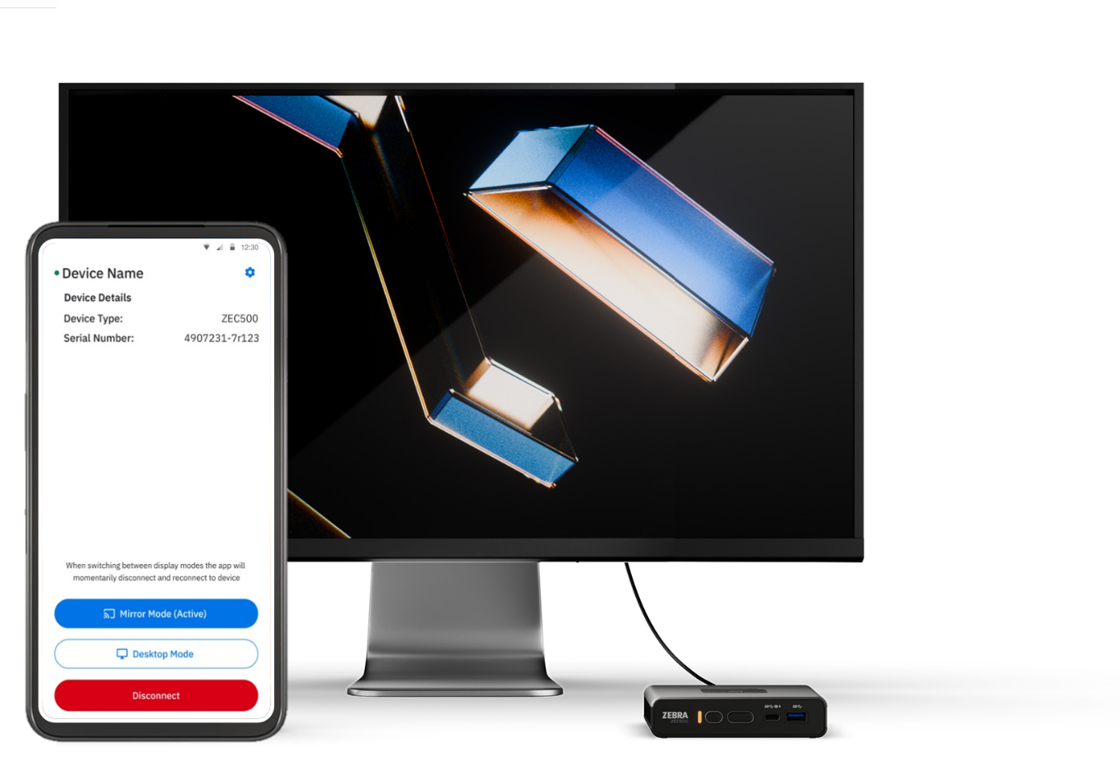

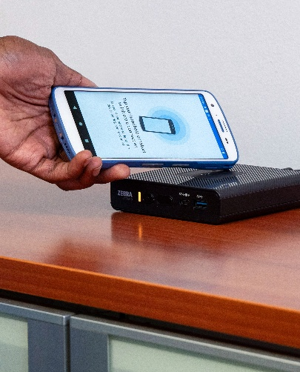
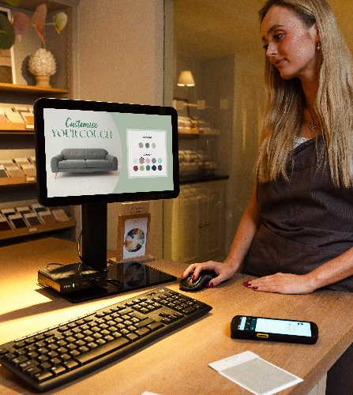

No docks. No cables. All flexibility.
Workstation Connect goes wireless.
Cast the screen of a Zebra mobile device
to an external display connected to a ZEC500
Choose mirroring or a full desktop experience
Share content and work on different apps on mobile device
and external display simultaneously
Interact with apps on the mobile device on a larger display
Use connected peripherals to interact with apps on the big
screen—such as a mouse, keyboard and printer
Seamless transition between mobile and fixed computing
Switch between handheld and desktop modes to meet the
needs of the moment
Mobile device remains fully functional — no missed calls or alerts

Slide 21
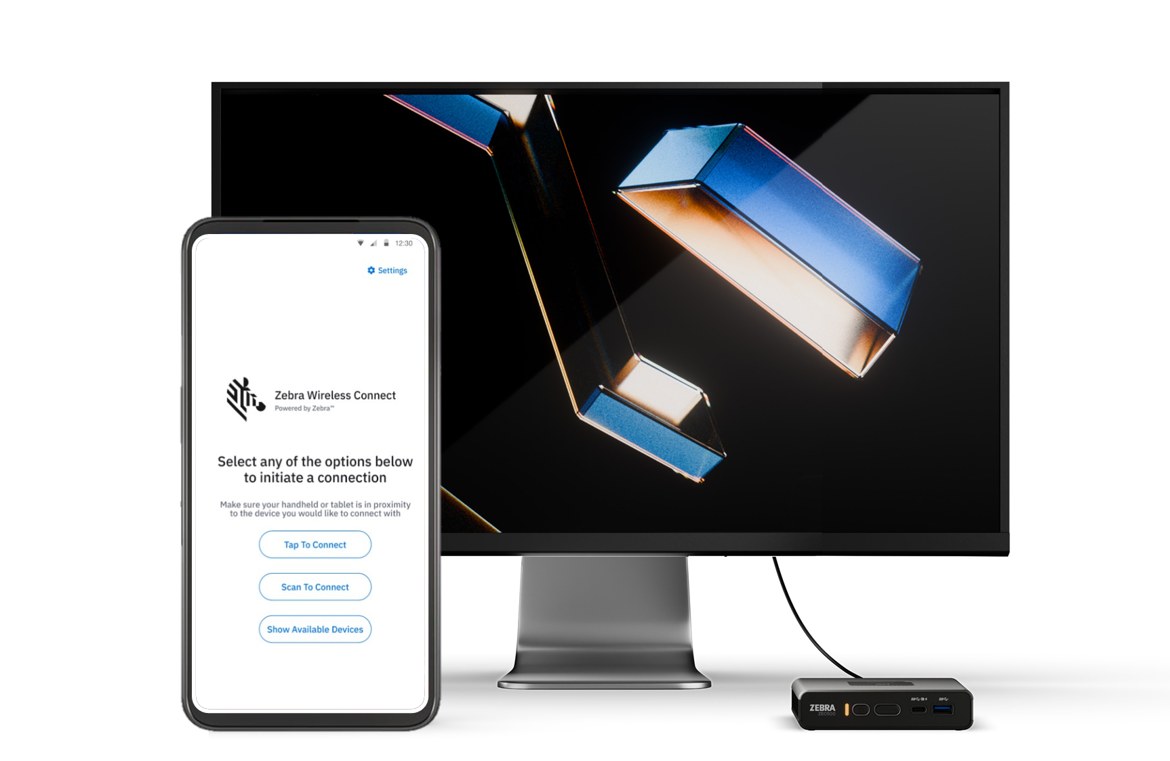
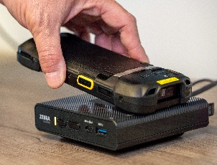
Wireless Workstation Connect
Connect with a simple scan or tap
Connect with a quick scan
Use the integrated scanner in Zebra mobile devices to scan a QR code displayed on the screen connected to the ZEC500
Connect with a one easy tap
Tap a supported Zebra mobile
device on the ZEC500 via the
integrated NFC feature on the
Zebra mobile device

Slide 22
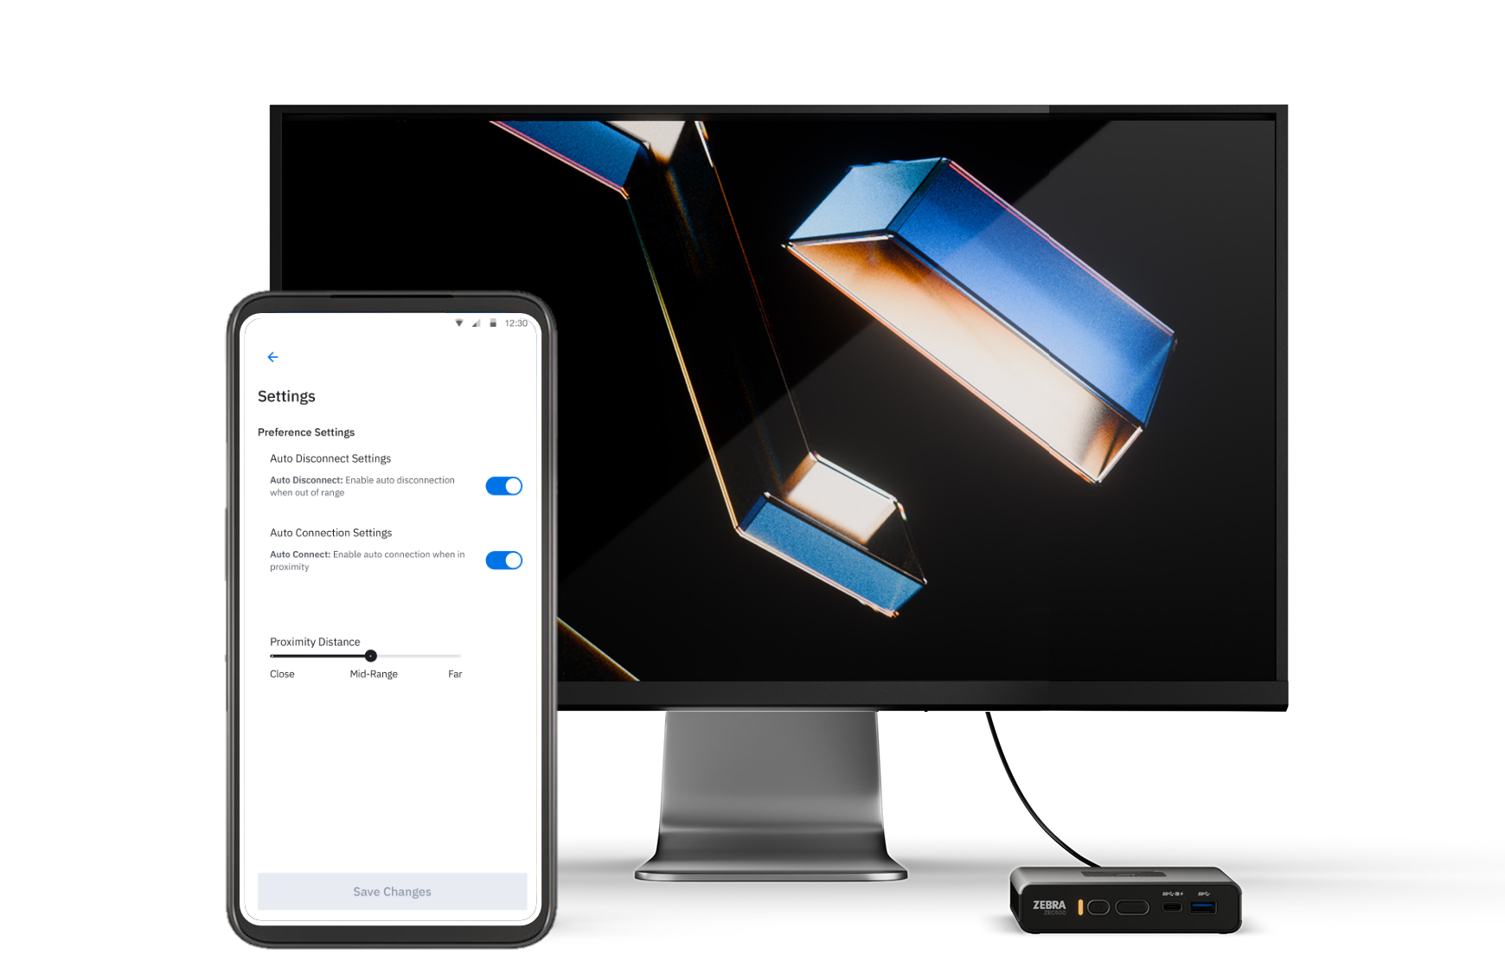
Wireless Workstation Connect
Connect and disconnect based on device proximity
Automatically initiate a
casting connection
Automatically connect a Zebra handheld or tablet previously connected to a ZEC500 Enterprise Computer whenever devices are in close range
Automatically terminate a casting connection
Automatically disconnect from an active casting session when walking away from a connected ZEC500 device

Slide 23
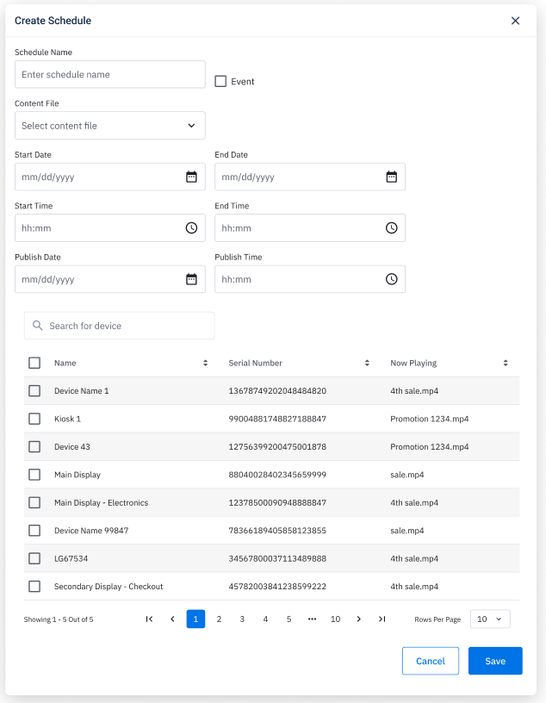

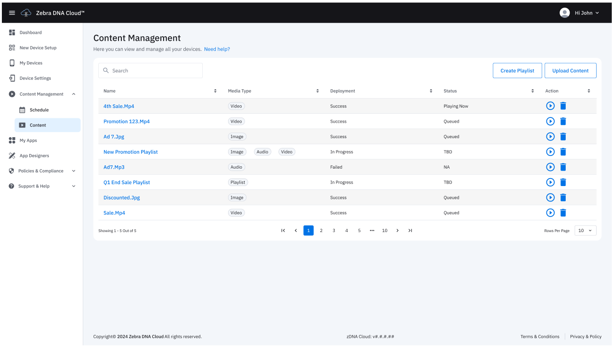
Zebra DNA Cloud
Delight customers and boost sales with effortless dynamic content management
Upload content files
Upload content to cloud console as a local file or as a file hosted on cloud. Once uploaded, preview imported content file prior to deployment
Create playlists and schedules
For files imported on Zebra DNA Cloud a schedule can be assigned that will control when content is displayed on devices
Configure device settings
Apply configurations to devices via DNA Cloud user interface, including enable or disable individual I/O ports

Slide 24

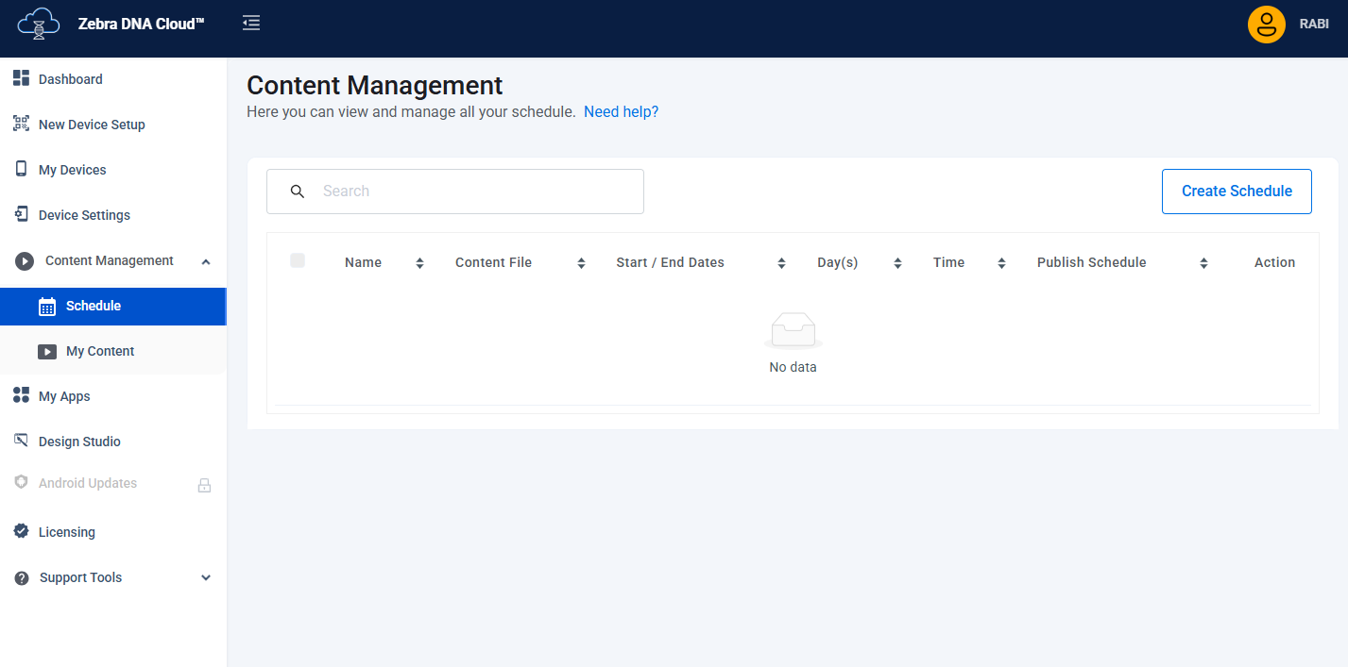
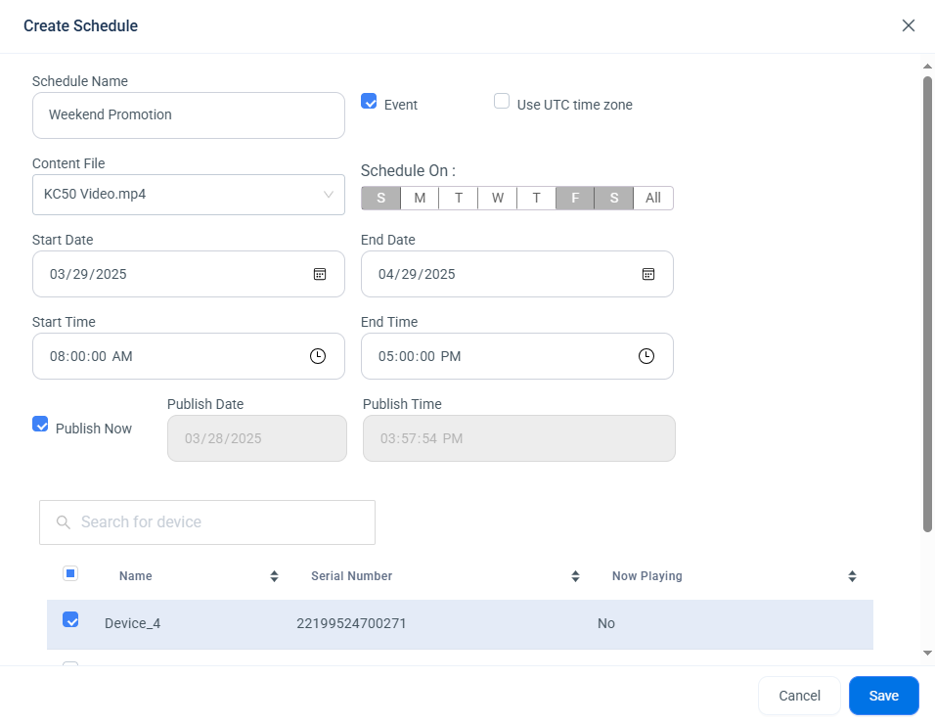
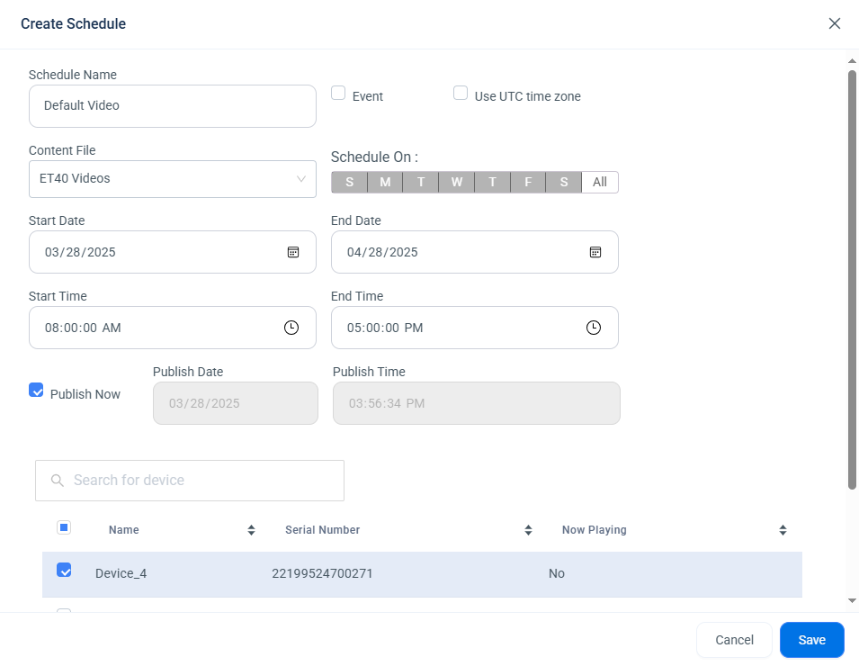
Create content schedule
DNA cloud content management

Slide 25




Unmatched value with Zebra DNA
no learning curve for your IT team. The many complimentary apps in this constantly growing toolkit maximize device value by minimizing the effort required to set up, secure, manage and optimize all your Zebra devices.
StageNow
Mobility Extensions (Mx)
Simplify device setup and management. With StageNow via Zebra DNA Cloud, effortlessly stage and configure devices, streamline enrollment into EMM, and manage deployment from a single interface.
Add powerful enterprise features to standard Android; choose from over 100 features to increase security, improve device manageability and more.
LifeGuard for Android
Zebra DNA Cloud
Delivers regular security updates over a device’s lifespan to protect against the latest cyber threats,
while always allowing you to migrate to new versions
at your own pace.*
Harness the power of Zebra DNA in one consolidated interface; intuitive interface makes it easy to deploy, manage and support your Zebra DNA tools.
* Requires a Zebra OneCare support contract
Notes:
.

Slide 26



















Zebra DNA for Mobile Computers
Set Up. Secure. Manage. Optimize. And manage all your Zebra DNA tools with Zebra DNA Cloud
Set Up
Secure and Manage
Optimize
DataWedge: Easily capture data and send to
your host applications without programming
Device Diagnostic Tool:
Instantly test and diagnose hardware operability to determine system health
Enterprise Home Screen: Control the user interface, including access
to applications and settings
Wireless Analyzer: Comprehensive network diagnostics for rapid identification and resolution of connectivity issues
Enterprise Mobility Development Toolkit (EMDK): Develop powerful customized enterprise applications with less time
and effort
GMS Restricted Mode: Gain data control and enhance security by controlling Google Mobile Services
RxLogger: Capture system and application logs to identify problems and avoid sending no-failure found devices for repair
Device Central: Simplified pairing, unpairing, locating and troubleshooting with Bluetooth® accessories
Enterprise Browser: Create cost-effective web-based applications optimized to work on Zebra Android devices
Enterprise Keyboard: Customized keys and layouts for specific workflows
LifeGuard for Android:
Protect devices from potential threats and access new features with regular updates and patches
Identity Guardian: Simple, secure and personalized access to shared devices with multifactor biometric facial login
StageNow: Stage a handful or thousands
of devices with the scan of a barcode or tap of an NFC tag
Mobility Extensions: A layer of enterprise features that are not available in off the shelf Android
OEM Config: Day one support for all device features in Mobility Extensions (Mx) via your EMM
Zebra DNA Cloud: Intuitive unified interface to easily deploy, manage and support your Zebra DNA tools
Wireless Insights: Real-time visibility of wireless network performance to troubleshoot and optimize connectivity
Zebra Zero Touch: Helps automate the setup of devices into your third-party management system
26

Slide 27
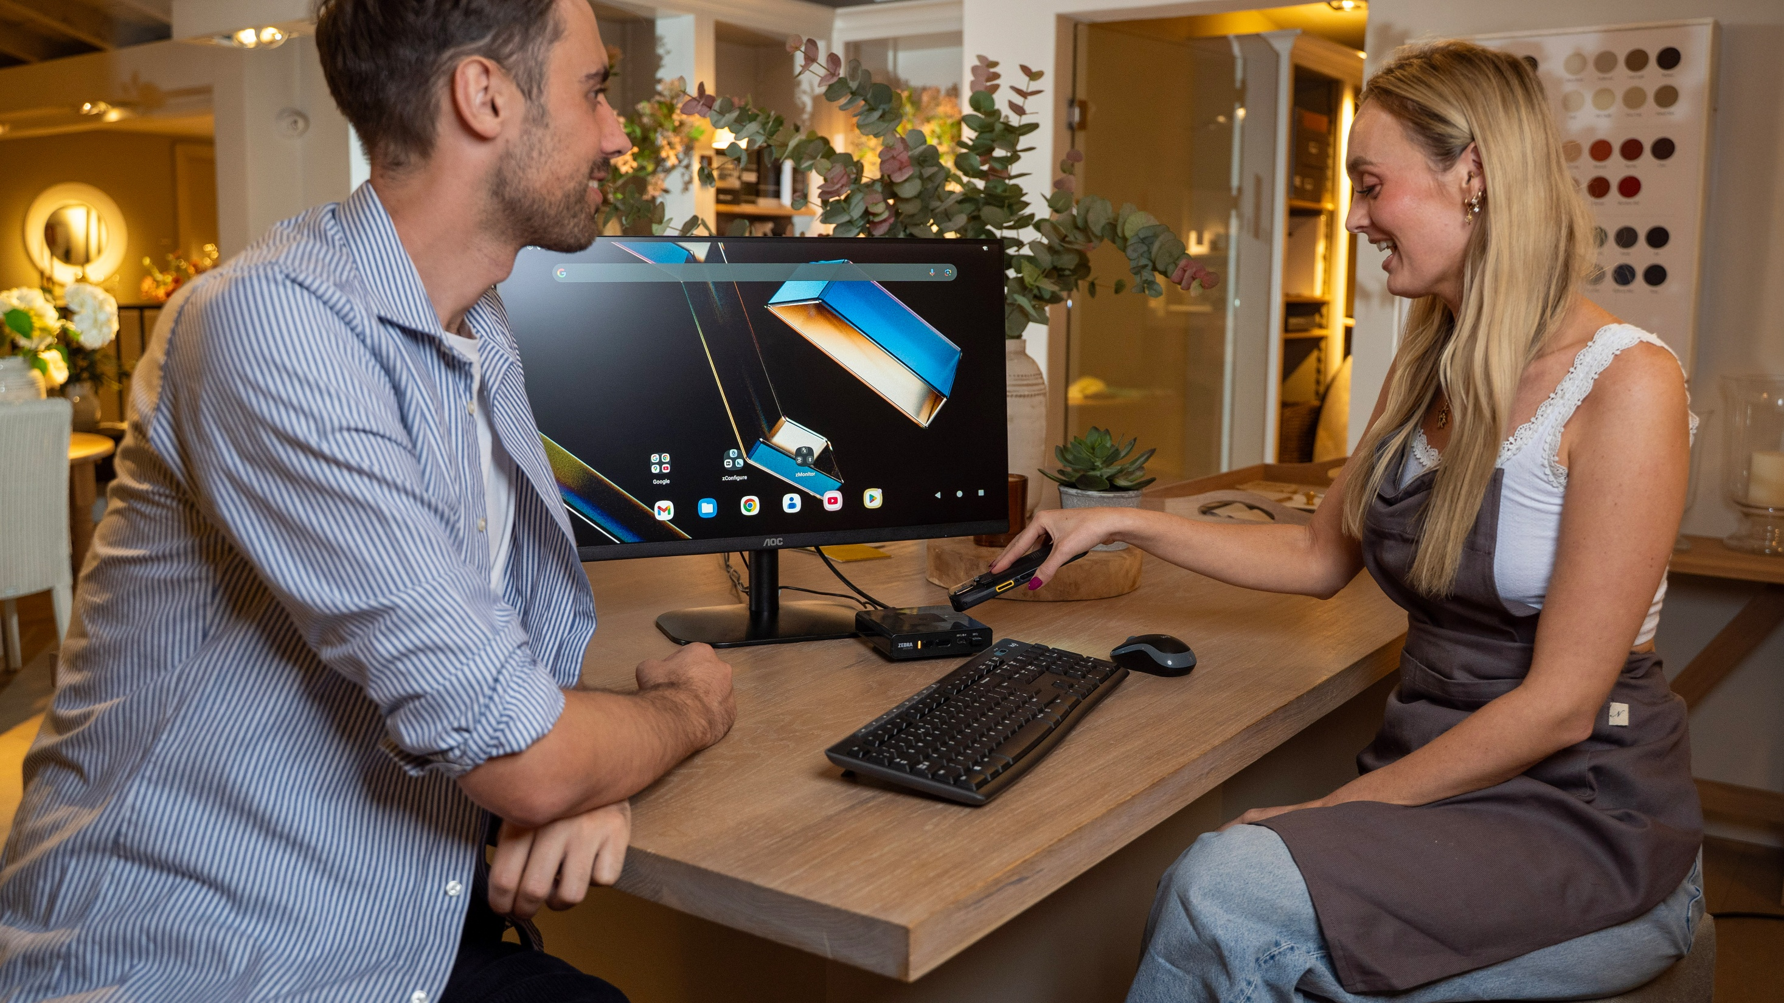
Product Tour

Slide 28
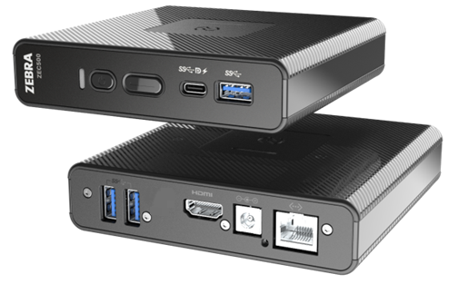
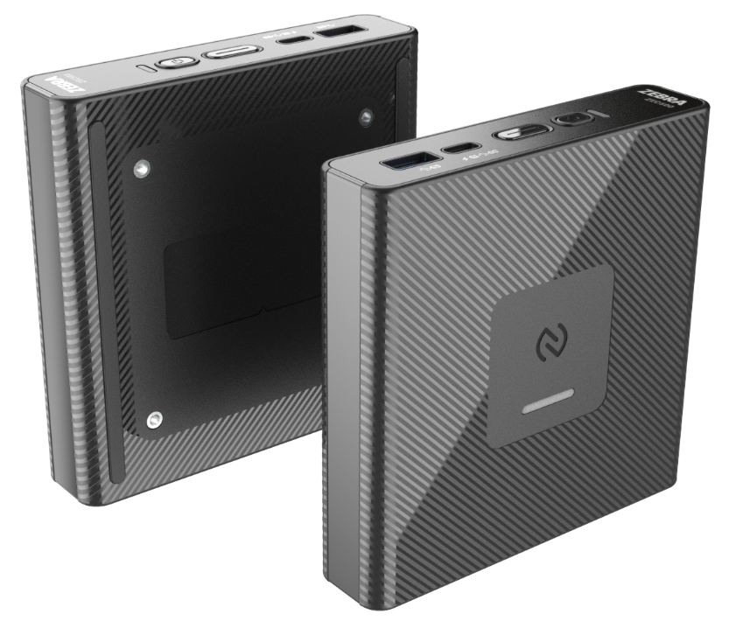
Value
ZEC500 Enterprise computer
Power key
Processor | 5430-FP2
Memory | 6GB RAM/ 64GB Flash
OS Version | A14 at release
Ethernet | 10/100/1000 via RJ45
WLAN | Wi-Fi6E 2x2 MU-MIMO
WPAN | BT 5.3 Class 2 with Bluetooth Low Energy (BLE)
NFC | ISO 14443 Type A and B; MIFARE, FeliCa and ISO 15693 cards; Card Emulation via Host
Connectivity Options | HDMI 2.0 USB-C 3.2 w/DisplayPort 1.4 and 5V,3A output USB-A (3.2) x 3
Display Resolution Supported | HDMI: 3840 x 2160 @30fps USB-C: 3840 x 2160 @60fps
Power | 24 VDC Zebra Power Supply
Operating Temp | 0°C (32°F) to +40°C (104°F) and -29°C (-20°F) to +60°C (140°F) (with optional fan)
Dimensions (mm) | 120Lx120Wx28H (without fan) 120Lx120Wx35H (with optional fan)
Programmable key
USB-C/DP
USB-A
HDMI
RJ45
NFC Antenna
75x75mm VESA

Slide 29
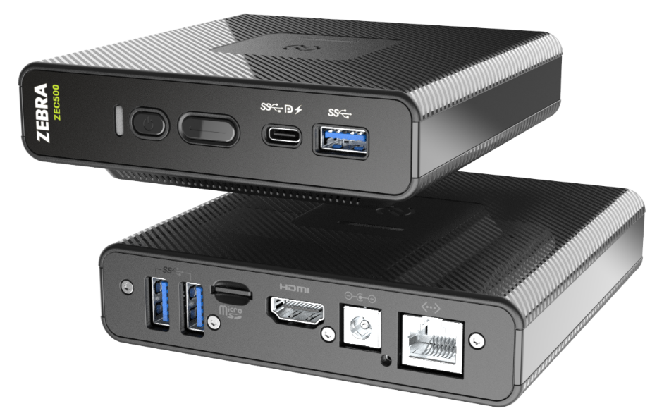
Premium
ZEC500 Enterprise computer
Power key
Processor | 5430-FP2
Memory | 8GB RAM/ 128GB Flash
OS Version | A14
Ethernet | 10/100/1000 via RJ45
WLAN | Wi-Fi6E 2x2 MU-MIMO
WPAN | BT 5.3 BLE Class 2
NFC | ISO 14443 Type A and B; MIFARE, FeliCa and ISO 15693 cards; Card Emulation via Host
Connectivity Options | HDMI 2.0 USB-C 3.2 w/DisplayPort 1.4, Power Delivery Input and 5V,3A output USB-A (3.2) x 3 Micro SD Card Slot
Display Resolution Supported | HDMI: 3840 x 2160 @30fps USB-C: 3840 x 2160 @60fps
Power | 24 VDC Zebra Power Supply Power Delivery Input via USB-C port Power over Ethernet: IEEE 802.3at/bt
Operating Temp | 0°C (32°F) to +40°C (104°F) and -29°C (-20°F) to +60°C (140°F) (with optional fan)
Dimensions (mm) | 120Lx120Wx28H (without fan) 120Lx120Wx35H (with optional fan)
Programmable key
USB-C/DP
USB-A
HDMI
RJ45
Micro-SD
NFC Antenna
75x75mm VESA

Slide 30

Services

Slide 31

The Industry Standard in Enterprise Support
Keep your operations running smoothly. Zebra OneCare™ support plans keep devices running at peak performance and ready for whatever the job demands
End-to-end coverage
Eliminates unpredictable repair-related costs. With Zebra OneCare, there are no surprises — if something is broken, we fix it
Technical support
Included in every plan; your users get support they can count on — fully trained technical professionals are available* to answer questions and address issues
LifeGuard™ for Android™
Included with every Zebra OneCare contract to ensure your devices are protected every day they are in service

Slide 32
Zebra OneCare™ Maintenance Plans
Tailor the plan that meets your business need
Feature | Zebra OneCare Essential Core assurance | Zebra OneCare Select Maximum protection
Live-agent support | Mon–Fri, 8–5 local time | 24/7
Repair turnaround time | 3-day repair turnarounds | ‘Like-new” replacement device ships for next business day delivery
Accidental damage covered
OS software and LifeGuard™ for Android™ security updates
Cloud-based visibility into repair, case reports and more with VisibilityIQ OneCare
Spares pool management
Commissioning Service Enhancement | Option to include Standard Commissioning | Option to include Standard Commissioning
BENEFITS
Genuine Zebra expertise and parts to maximize device uptime
LifeGuard for Android Security Support, Protect your business and ensure your devices are always running at optimum performance levels
Outstanding value – eliminates unexpected repair costs with a planned maintenance plan
Cloud-based Visibility to Repairs and More, Detailed insight into repair and support information, contracts, case & lifecycle reports
True service from the source – No one knows Zebra devices and its software better than Zebra
✓
✓
✓
✓
✓
✓
✓
32

Slide 33


Why Zebra

Slide 34













Why Zebra
Extensive Reach
Scalable to meet any
enterprise demands
Leader Status
Gartner Magic Quadrant for Indoor Location Services—Global
Our People
Make the Difference
Channel
Accolades
$4.58B
Global sales
#1
120
Offices globally
Rugged
Mobile Computing
~6.8K Patents and
patent applications worldwide
Data Capture
9.75K+
Employees worldwide in
55 countries
Barcode Printing
10K+ Channel
Partners in over 185 countries
~11%
of sales R&D
Mobile RFID
Sources: VDC Research and Zebra analysis (f#1 market share), Gartner, Magic Quadrant for Indoor Location Services, Tim Zimmerman, Annette Zimmermann, 21 February 2023. (Leader Status)

Slide 35
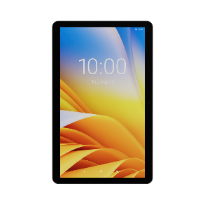

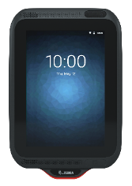
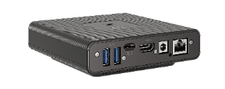
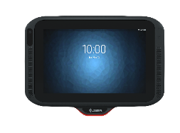
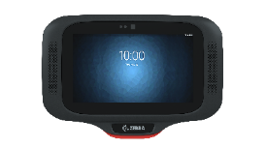
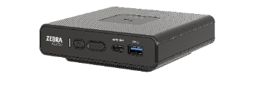
Zebra Android Kiosk Portfolio
Multiple modalities to optimize use cases
Any size
Large 15” and 22”
Medium (10 inch)
Small (5 inch)
Headless computers
All-in-one computers
All-in-one computers
All-in-one computers
ZEC500 with ANY size display or
use Zebra TD50 15” Touch Display
KC50 15” and 22” kiosk
computers with a complete family of accessories, including stands
CC6000 All-in-One
10” kiosk
CC600 All-in-One
5” kiosk
Digital signage/
Retail Media Network
Wireless and stand-alone workstations
Self service
Endless aisle
Queue management
Point of Sale (POS)
Price checker
Personal shopper head unit
Time and attendance
Price checker
Personal shopper head unit
Time and attendance
35

Slide 36
Thank you
www.zebra.com/zec500
ZEBRA and the stylized Zebra head are trademarks of Zebra Technologies Corp., registered in many jurisdictions worldwide. Android is a trademark of Google LLC. All other trademarks are the property of their respective owners. ©2025 Zebra Technologies Corp. and/or its affiliates.

